Slide 1
Understanding T-SQL Programming Logic

Slide 2
Variables
Declaring and Initializing a Variable:
DECLARE @variableName <type>[(size)] = <value1>
SET @variableName = <value2>
Using Expressions and Functions with Variables

Slide 3
Using Variables in WHERE and HAVING Clauses

Slide 4
1. Write a script that declares an integer variable called @myInt. Assign 10 to thevariable, and then print it.
2. Write a script that declares a VARCHAR(20) variable called @myString. Assign “This is a test” to the variable, and print it.
3. Write a script that declares two integer variables called @MaxID and @MinID. Use the variables to print the highest and lowest SalesOrderID values from the Sales.SalesOrderHeader table.
4. Write a script that declares an integer variable called @ID. Assign the value 70000 to the variable. Use the variable in a SELECT statement that returns all the rows from the Sales.SalesOrderHeader table that have a SalesOrderID greater than the value of the variable.
5. Write a script that declares three variables, one integer variable called @ID, a NVARHCAR(50) variable called @FirstName, and a VARCHAR(50) variable called @LastName. Use a SELECT statement to set the value of the variables with the row from the Person.Person table with BusinessEntityID = 1. Print a statement in the “BusinessEntityID: FirstName LastName” format.
6. Write a script that declares an integer variable called @SalesCount. Set the value of the variable to the total count of sales in the Sales.SalesOrderHeader table. Use the variable in a SELECT statement that shows the difference between the @SalesCount and the count of sales by customer.

Slide 5
The IF… ELSE Construct
IF <condition> <statement>
IF <condition>
<statement>
IF <condition> BEGIN
<statement1>
[<statement2>]
END

Slide 6
Using ELSE
IF <condition> <statement> ELSE <statement>
IF <condition> BEGIN
<statement1>
[<statement2>]
END
ELSE <statement>
IF <condition> BEGIN
<statement1>
[<statement2>]
END
ELSE BEGIN
<statement1>
[<statement2>]
END

Slide 7
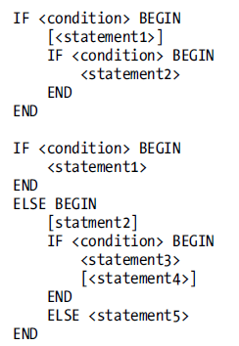
Using Multiple Conditions
Using Multiple Conditions
Nesting IF…ELSE

Slide 8
Using IF EXISTS
IF [NOT] EXISTS(SELECT * FROM <TABLE1> [WHERE <condition>]) BEGIN
<statement1>
[<statement2>]
END

Slide 9
1. Write a batch that declares an integer variable called @Count to save the count of all the Sales.SalesOrderDetail records. Add an IF block that that prints “Over 100,000” if the value exceeds 100,000. Otherwise, print “100,000 or less.”
2. Write a batch that contains nested IF blocks. The outer block should check to see whether the month is October or November. If that is the case, print “The month is ” and the month name. The inner block should check to see whether the year is even or odd and print the result. You can modify the month to check to make sure the inner block fires.
3. Write a batch that uses IF EXISTS to check to see whether there is a row in the Sales. SalesOrderHeader table that has SalesOrderID = 1. Print “There is a SalesOrderID = 1” or “There is not a SalesOrderID = 1” depending on the result.

Slide 10
WHILE
Using a WHILE Loop
WHILE <condition> BEGIN
<statement1>
[<statement2>]
END

Slide 11
Using ROWCOUNT
Nesting WHILE Loops
Exiting a Loop Early
Using CONTINUE

Slide 12
1. Write a script that contains a WHILE loop that prints out the letters A to Z. Use the function CHAR to change a number to a letter. Start the loop with the value 65. Here is an example that uses the CHAR function:
DECLARE @Letter CHAR(1);
SET @Letter = CHAR(65);
PRINT @Letter;
2. Write a script that contains a WHILE loop nested inside another WHILE loop. The counter for the outer loop should count up from 1 to 100. The counter for the inner loop should count up from 1 to 5. Print the product of the two counters inside the inner loop.
3. Change the script in question 2 so the inner loop exits instead of printing when the counter for the outer loop is evenly divisible by 5.
4. Write a script that contains a WHILE loop that counts up from 1 to 100. Print “Odd” or “Even” depending on the value of the counter.

Slide 13
Error Handling
Using @@ERROR
The @@ERROR function returns a number greater than zero if an error exists.
Using TRY … CATCH
BEGIN TRY
<statements that might cause an error>
END TRY
BEGIN CATCH
<statements to access error information and deal with the error>
END CATCH

Slide 14
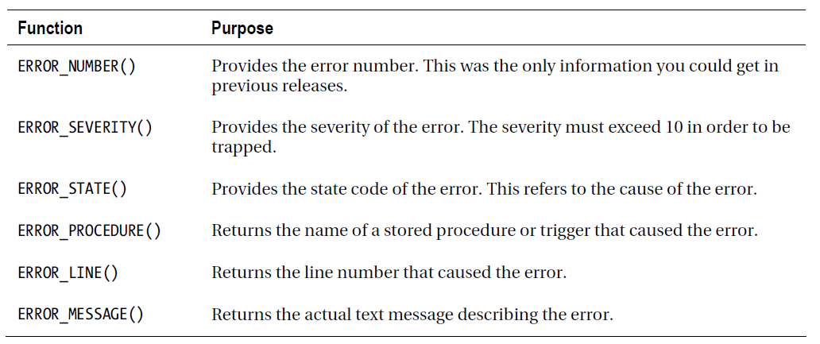

Slide 15
RAISERROR(<message>,<severity>,<state>)
Using TRY…CATCH with Transactions
Using THROW Instead of RAISERROR
THROW [ { error_number | message | state } ] [ ; ]
Keep in mind the statement prior to the THROW command must end in a semicolon!

Slide 16
EXCERCISE
1. Write a statement that attempts to insert a duplicate row into the HumanResources.Department table. Use the @@ERROR function to display the error.
2. Change the code you wrote in question 1 to use TRY…CATCH. Display the error number, message, and severity.
3. Change the code you wrote in question 2 to raise a custom error message instead of the actual error message.

Slide 17
Temporary Tables and Table Variables
Creating Local Temp Tables (#) (WITHIN CONNECTION)
tempDB database
INTO
CREATE TABLE #tableName (<col1> <data type>,<col2> <data type>)
Creating Global Temp Tables (ALL CONNECTIONS)

Slide 18
Creating Table Variables
DECLARE @tableName TABLE (<col1> <data type>,<col2> <data type>)
Using a Cursor (very slow)

Slide 19
excercise
1. Create a temp table called #CustomerInfo that contains CustomerID, FirstName, and LastName columns. Include CountOfSales and SumOfTotalDue columns. Populate the table with a query using the Sales.Customer, Person.Person, and Sales.SalesOrderHeader tables.
2. Change the code written in question 1 to use a table variable instead of a temp table.
3. Create a table variable with two integer columns, one of them an IDENTITY column. Use a WHILE loop to populate the table with 1,000 random integers using the following formula. Use a second WHILE loop to print the values from the table variable one by one.
CAST(RAND() * 10000 AS INT) + 1

